Slide 1
Base qiime2 data

Slide 2
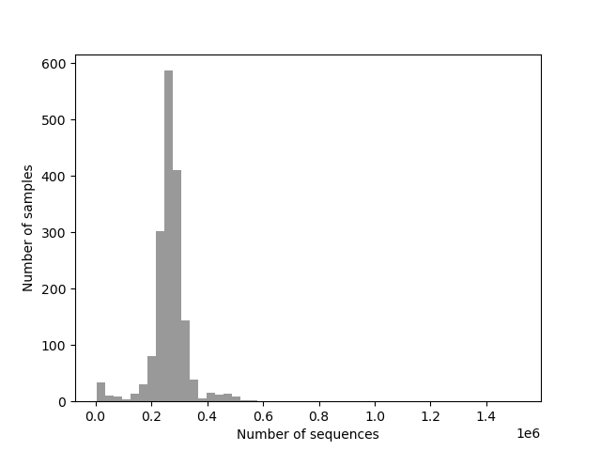
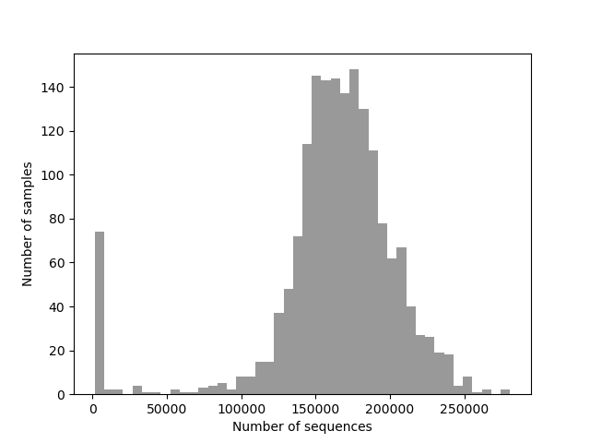
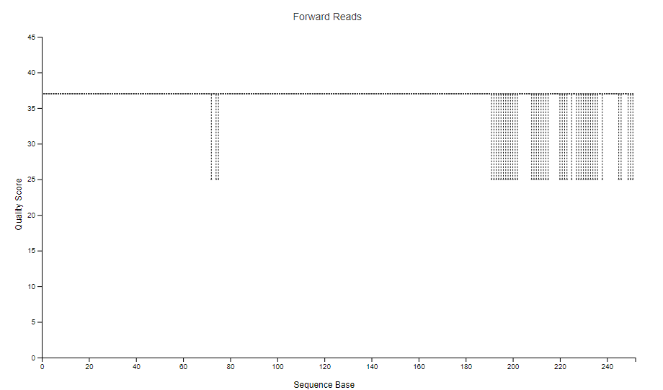
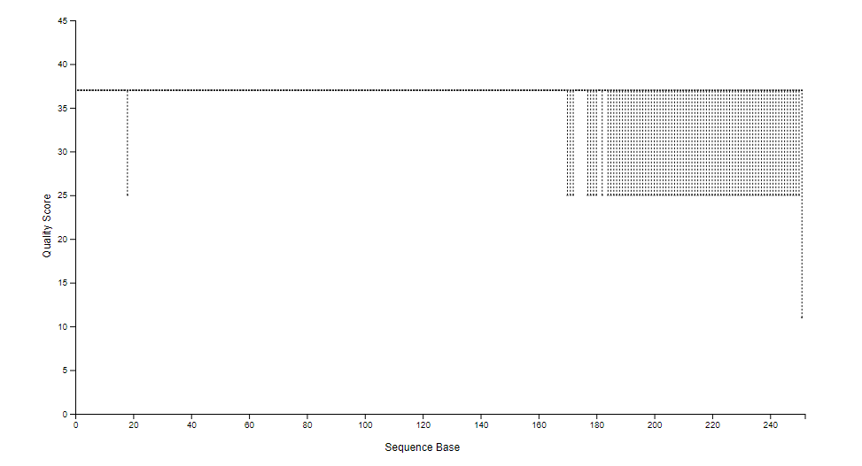
16S raw data
ITS raw data
1731 samples, 266kreads/sample
460M total reads
1731 samples, 162kreads/sample
280M total reads

Slide 3
All pre-processing done on qiime2
No trimming of sequence edges
Cutadapt plugin for primer removal
Very basic dada2
 | 16S | ITS
Passed filter (%) | 85±2 | 80±6
Merged (%) | 65±9 | 77±9
Non-chimeric (%) | 52±14 | 75±9
Number of features | 564K | 20K
Total frequency | 223M | 203M
Non-microbial DNA | 43% | 25%
Frequency filtered features (≥8) | 148K | 14K
Frequency filtered reads(≥8) | 123M | 184M
Rarefaction | 15K | 25K
Samples/ASVs lost at rarefaction | 44/11K | 64/0.2k
qiime dada2 denoise-paired \
--i-demultiplexed-seqs 16S_preDada2_TrimmedPrimers.qza \
--p-trunc-len-f 0 \
--p-trunc-len-r 0 \
--p-max-ee-f 1 \
--p-max-ee-r 1 \
--p-n-threads 0 \
--o-table feature-table_16S_noTrunc.qza \
--o-representative-sequences rep-seqs_16S_noTrunc.qza \
--o-denoising-stats denoising-stats_16S_noTrunc.qza
Takes 6 days to process with 10 CPUS, 128GB Ram (€50)
Sklearn on retrained classifiers
16S: Silva138, cut to size and primers
ITS: Unite 8.3 developer version (no trimming)
Non-microbial DNA based on taxa classification
Filtering ASVs ≥8 (as in UNOISE ZOTUs)

Slide 4
Dada2 error correction
Ernakovich lab

Slide 5
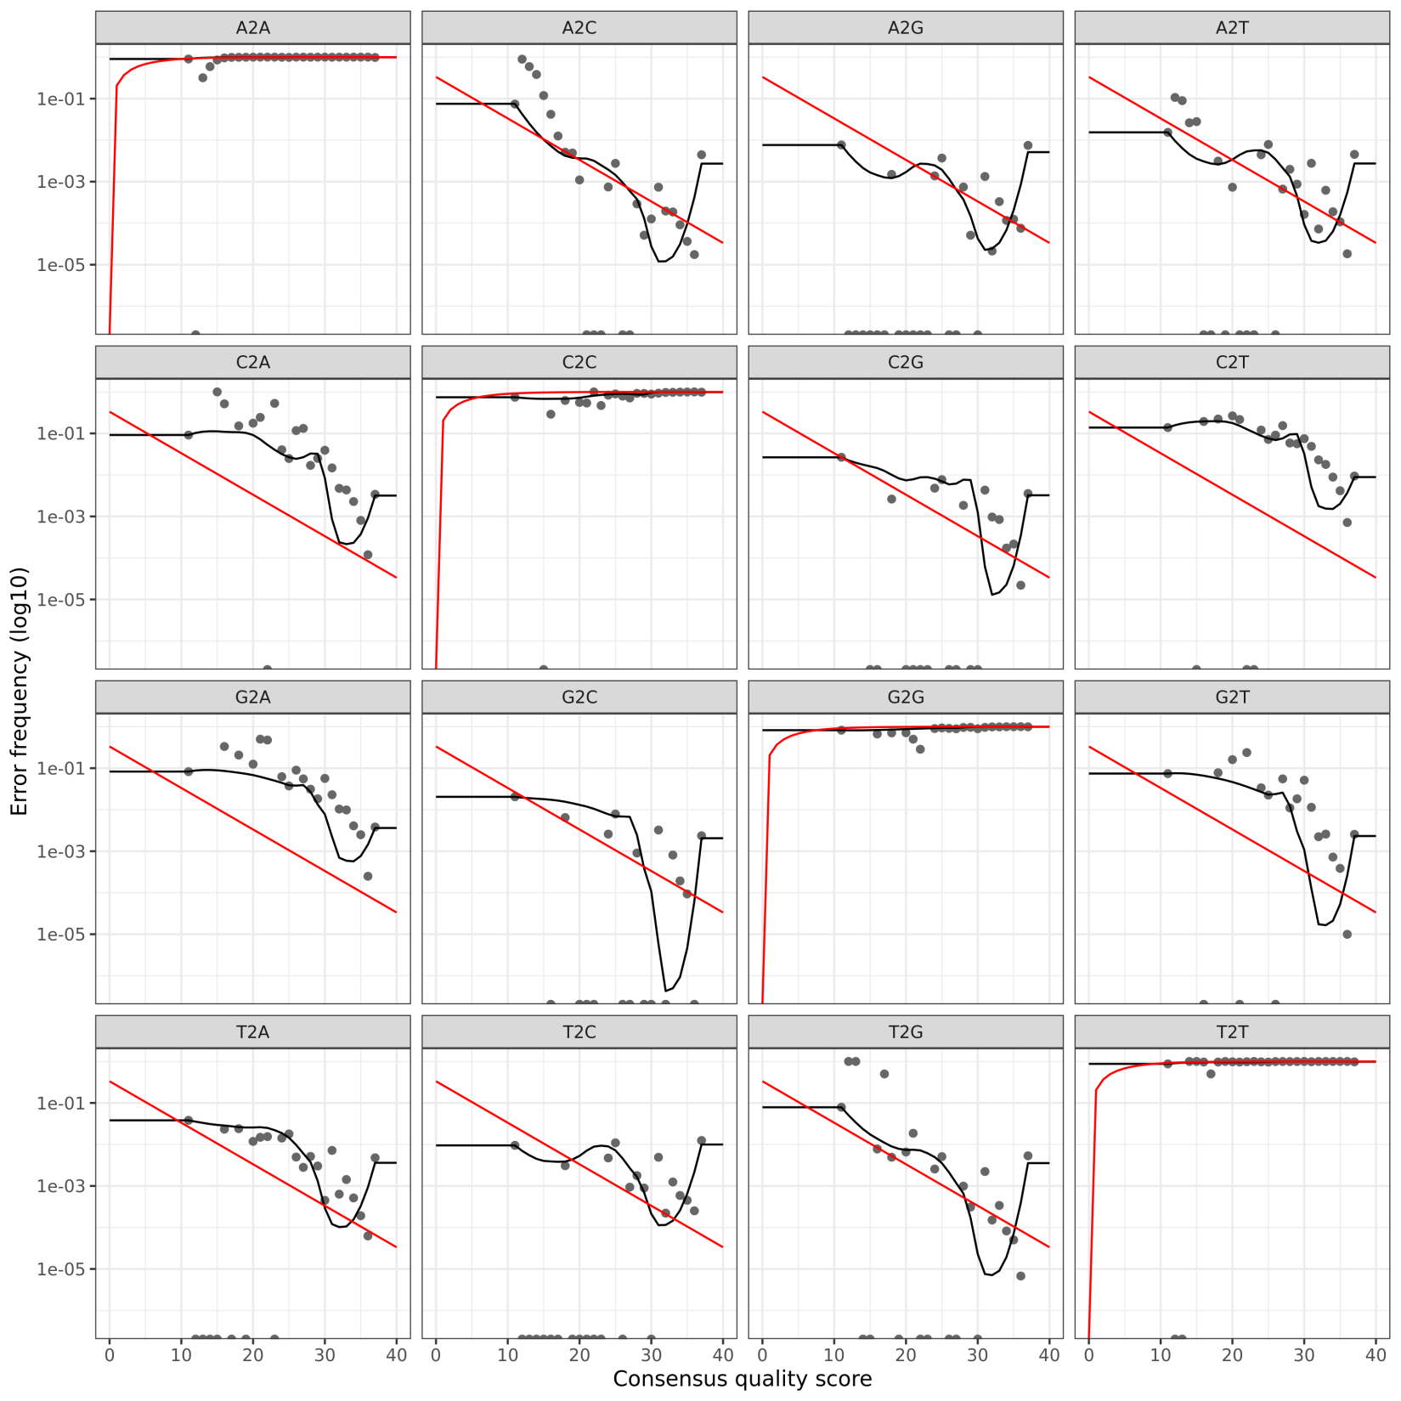
Standard dada2
Valley depression
Forward reads

Slide 6
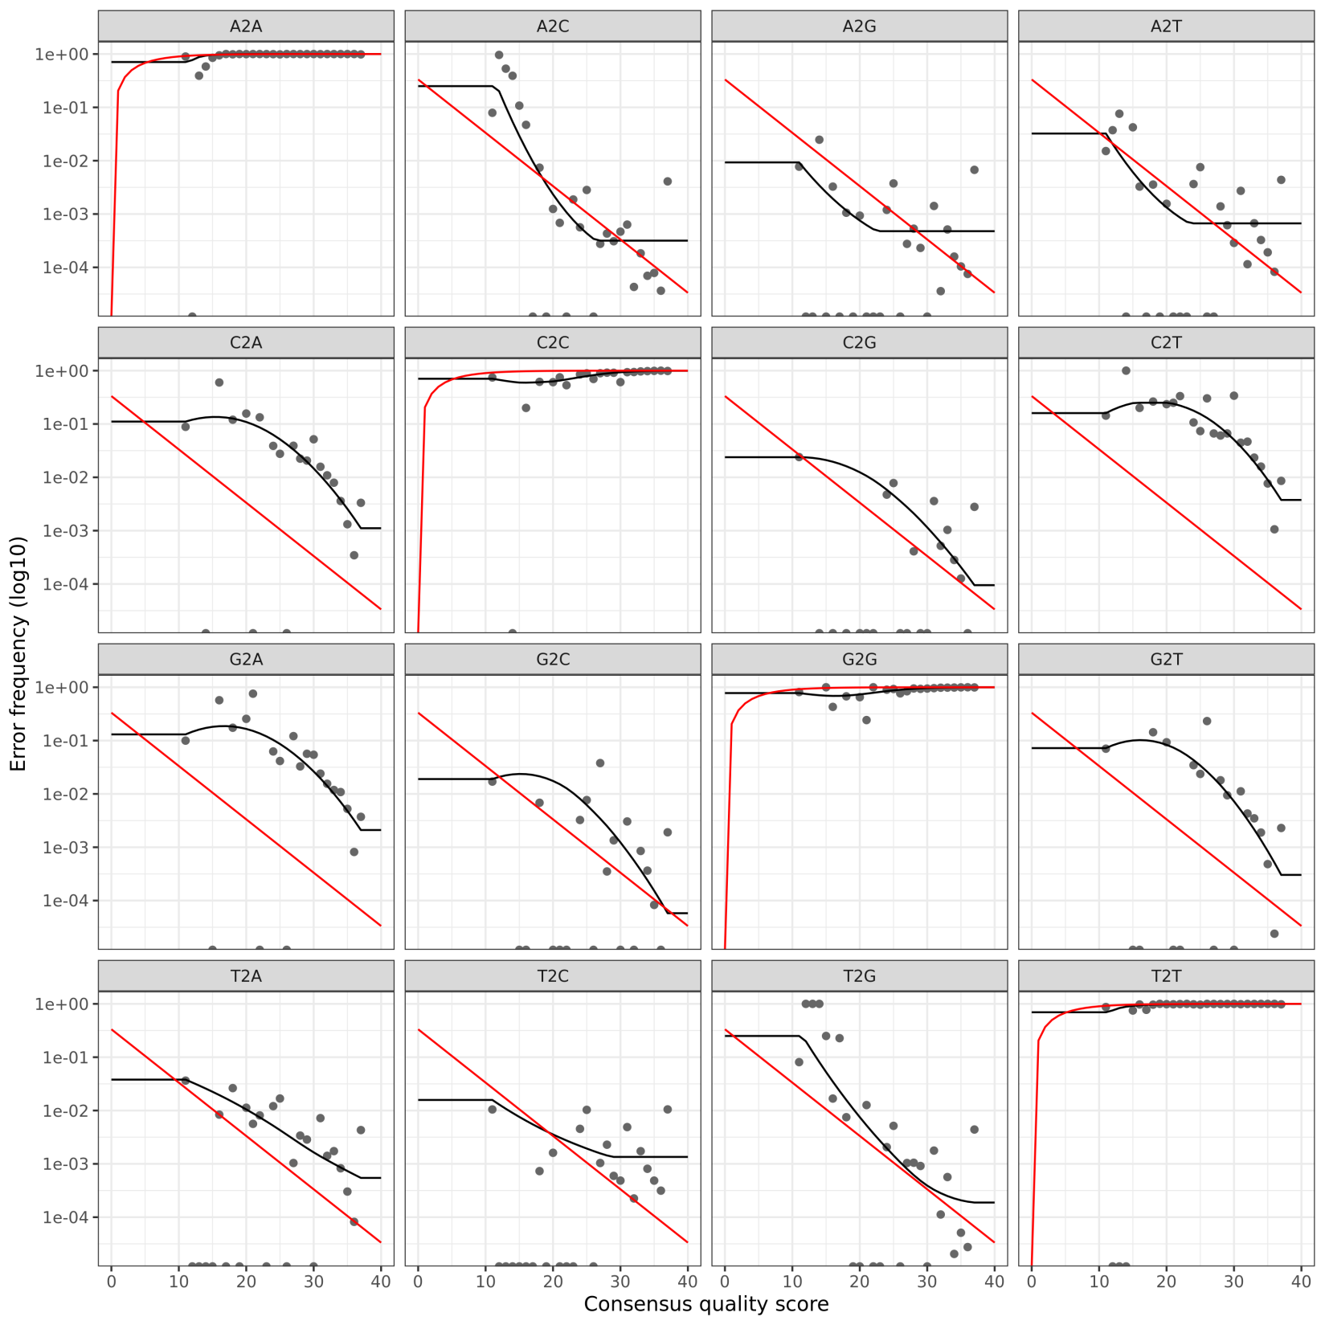
Error correction version 1
Bumps and flatlines
Forward reads

Slide 7
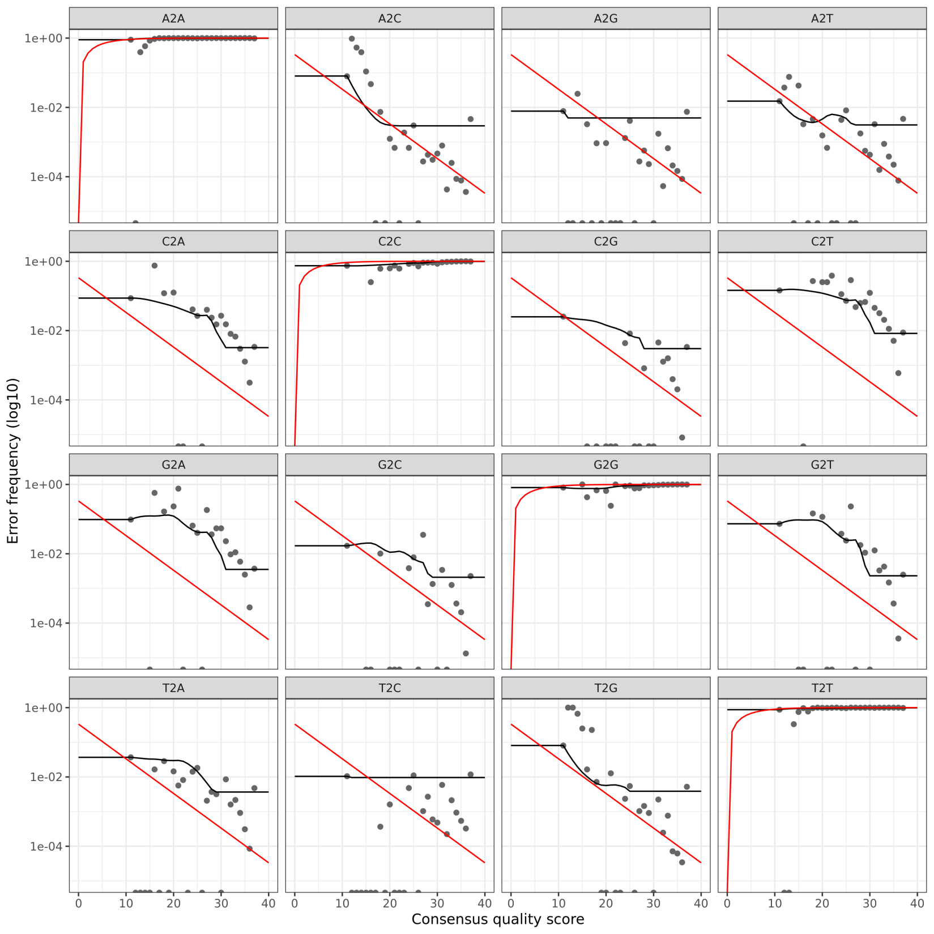
Error correction version 2
Bumps and flatlines
Forward reads

Slide 8
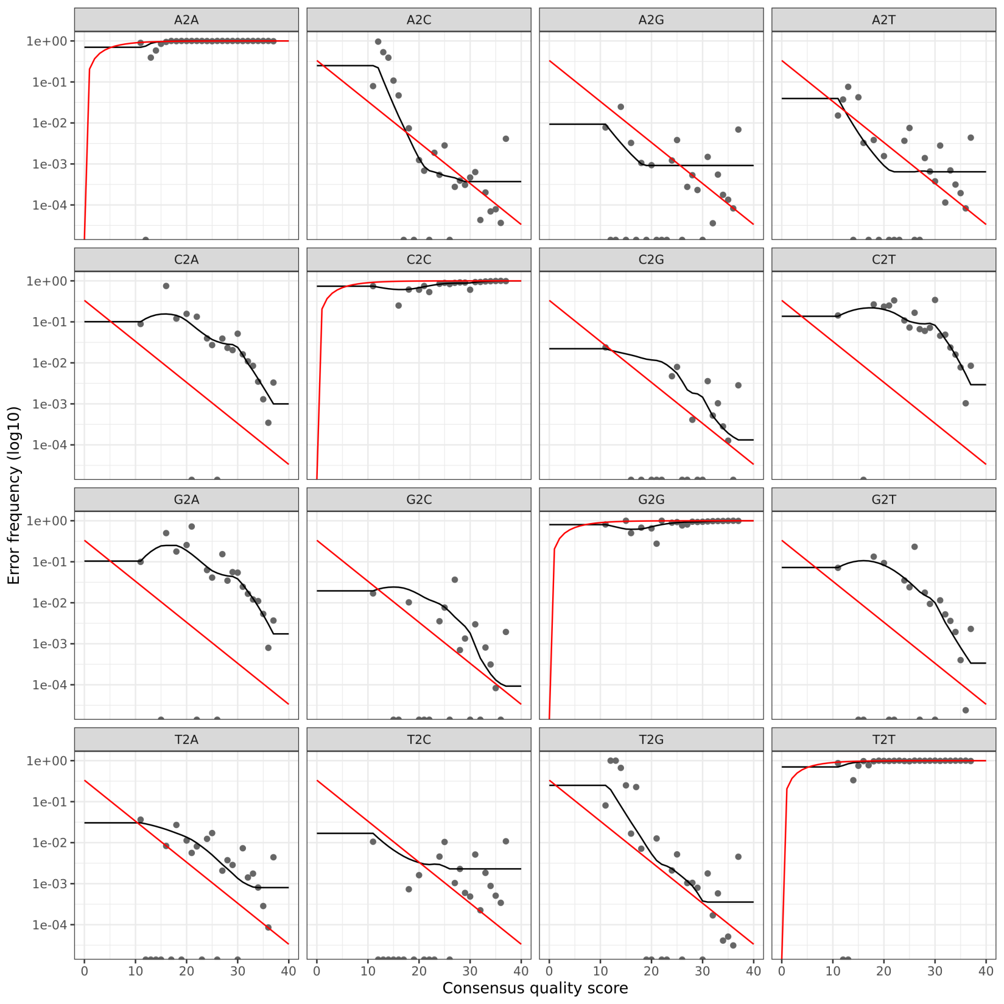
Error correction version 3
Bumps and flatlines
Forward reads

Slide 9
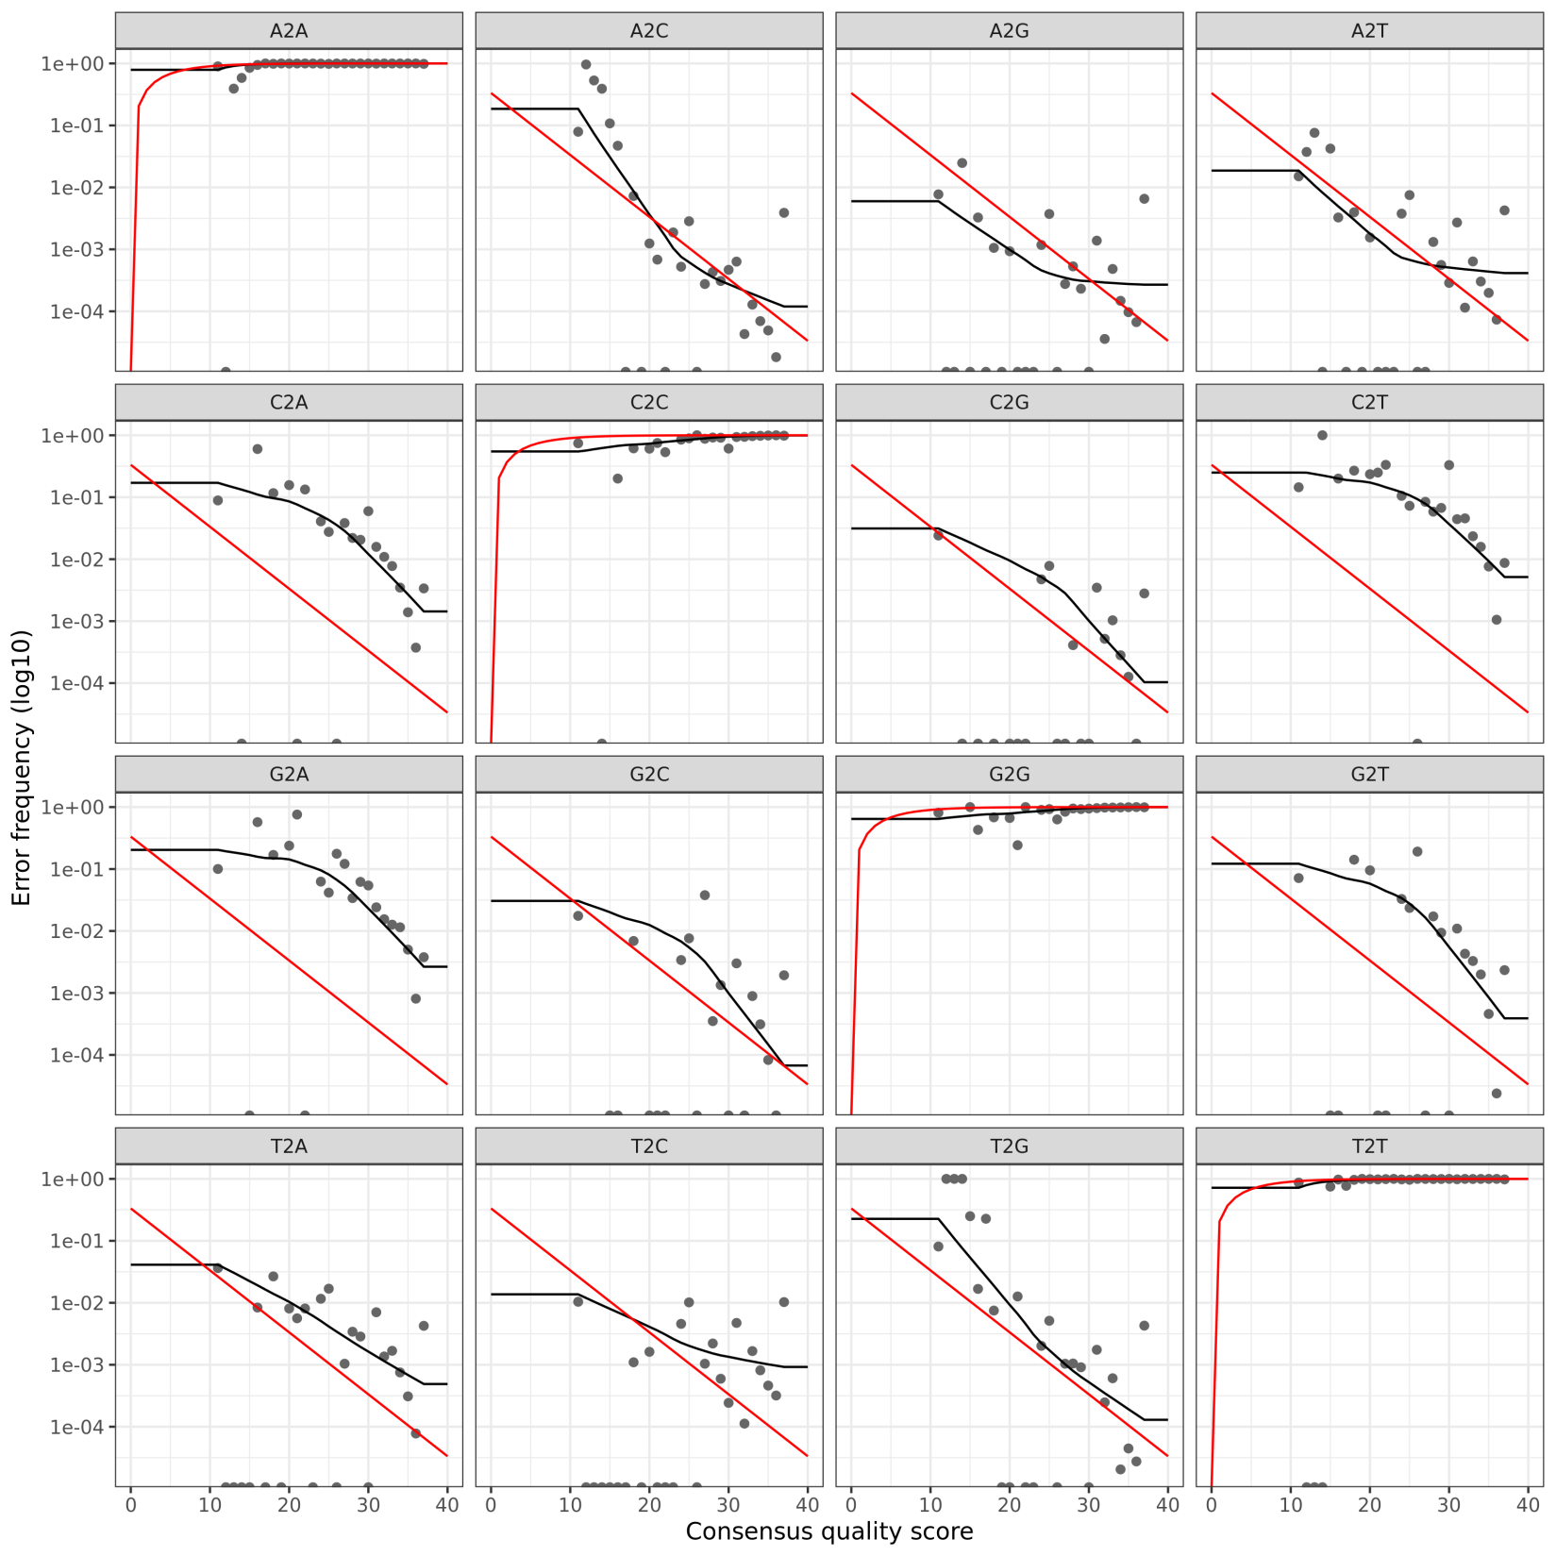
Error correction version 4
No clear bumps or flatlines
Optimal performance
Forward reads

Slide 10
PERFect package discussion

Slide 11
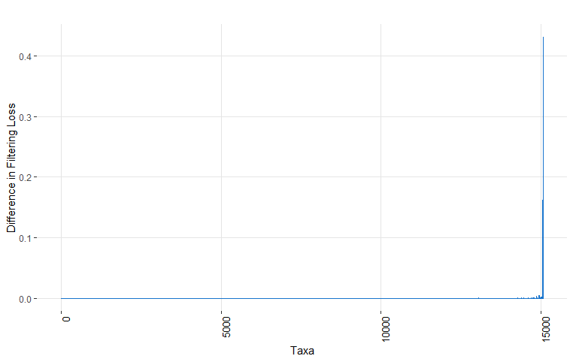

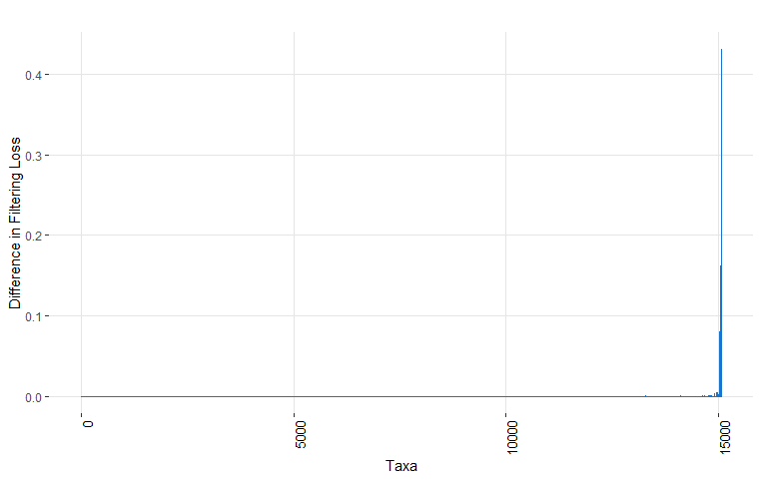
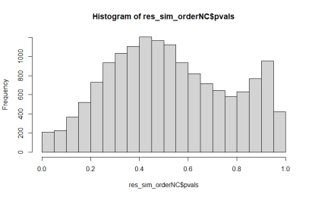
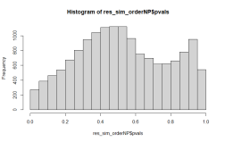
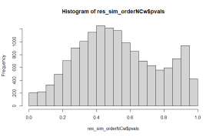
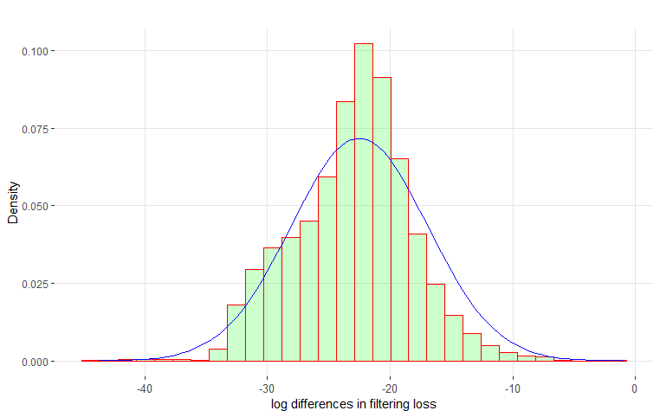


PERFect_sim
Alpha = 0.1, distr = “sn”
fit$value
[1] 0.06915217
Order = "NP"
Order = "NC"
Order = "NCw"
fit$value
[1] 0.06966798
Alpha = 0.1
Alpha = 0.1
fit$value
[1] 0.06915412
Kept 15065 out of 15083 taxa!
Kept 15082 out of 15083 taxa!
Kept 15065 out of 15083 taxa!

Slide 12



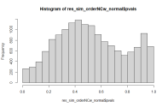
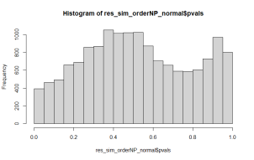
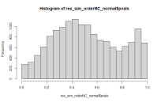

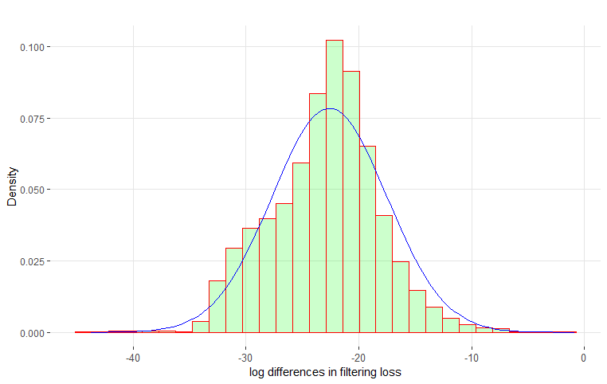

PERFect_sim
Alpha = 0.1, distr = “normal”
Order = "NP"
Order = "NC"
Order = "NCw"
fit$estimate
mean sd
-22.598993 5.088638
fit$value
[1] 5.918337e-10
fit$hessian
mean sd
mean 4.00000 -1.3489795
sd -1.34898 0.9098728
fit$estimate
mean sd
-22.597593 5.089484
fit$value
[1] 1.366171e-10
fit$hessian
mean sd
mean 4.00000 -1.3489795
sd -1.34898 0.9098728
fit$estimate
mean sd
-22.597601 5.089407
fit$value
[1] 1.583094e-09
fit$hessian
mean sd
mean 4.00000 -1.3489795
sd -1.34898 0.9098728
Kept 15065 out of 15083 taxa!
Kept 15065 out of 15083 taxa!
Kept 15082 out of 15083 taxa!

